Slide 1
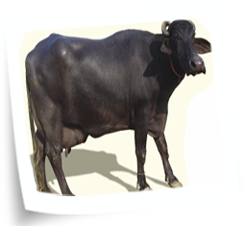
1. Murrah
Haryana, Nabha and Patiala districts of Punjab and southern parts of Delhi state. Otherwise called as Delhi, Kundi and Kali.

Slide 2
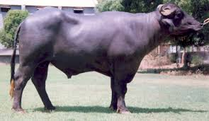
Butter fat content is 7.83%. Average lactation yield is varying from
1500 to 2500 kgs per lactation.

Slide 3
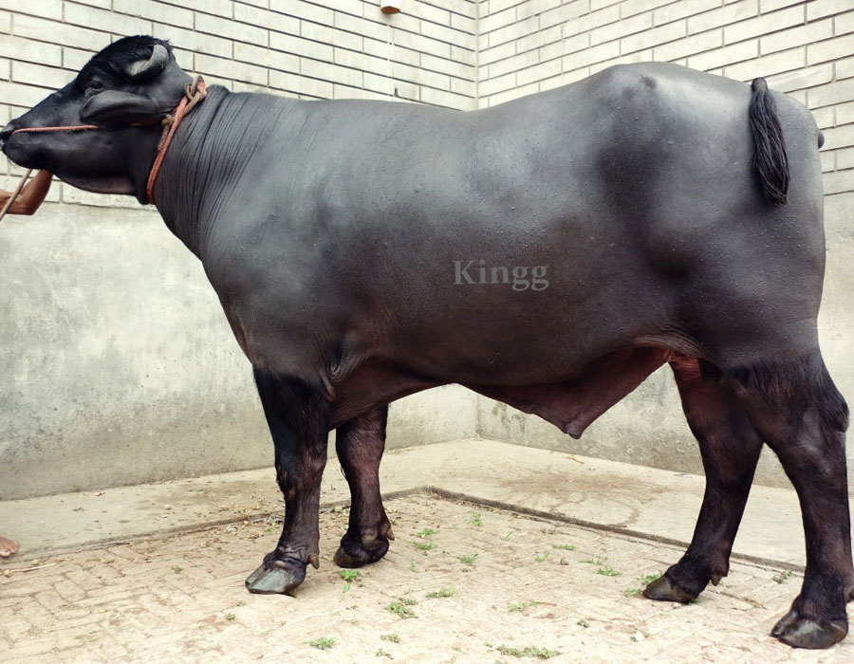
Bull

Slide 4
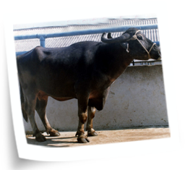
2. Surti Kaira and Baroda district of Gujarat.
1000 to 1300 kgs per lactation. The peculiarity of this breed is very high fat percentage in milk (8-12per cent).

Slide 6
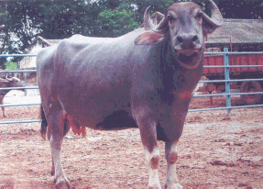

Slide 7
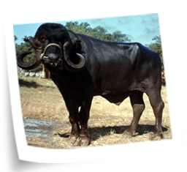
3. Jaffrabadi
1000 to 1200 kgs

Slide 8
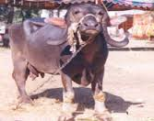

Slide 9
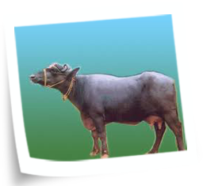
4. Bhadawari
Agra and Etawah district of Uttar Pradesh and Gwalior district of Madhya Pradesh.

Slide 10
800 to 1000 kgs

Slide 11
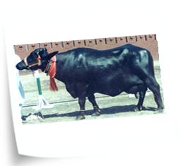
5. Nili Ravi
This breed is found in Sutlej valley in Ferozpur district of Punjab and in the Sahiwal (Pakistan) of undivided India.
1500-1850
1500-1850

Slide 12
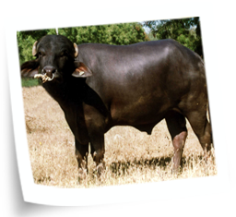
6. Mehsana
Mehsana, Sabarkanda and Banaskanta districts in Gujarat and adjoining Maharashtra state.

Slide 13
1200-1500 kgs

Slide 14
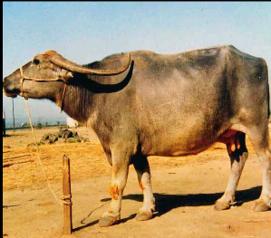
7. Nagpuri
Elitchpuri or Barari.
The breeding tract of this breed is Nagpur, Akola and Amrawati districts of Maharashtra.
700 to 1200 kgs

Slide 15
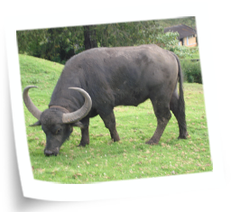
8. Toda
This buffalo is named after an ancient tribe, Toda of Nilgiris Hills of south India and it is a semi-wild breed.
500 kgs

