Slide 1
VITAMINS
v.sumalatha

Slide 2
VITAMINS - deficiency diseases
History of vitamins :
The story of vitamin dates back to 18th century.
Sailors of this period knew that eating of liver cures a disease called night blindness and
Eating of lemons cures another disease called scurvy.
Also cod liver oil cures a disease called rickets
In 1912, Sir H.G. Hopkins first identified Vitamins in MILK and named it as Accessory factors.
Funk named the accessory factors as Vitamins (Vital amines).

Slide 3
Vitamins are micronutrients, which are very much essential for growth and for metabolism.
If antibiotics are indiscriminately taken, the bacteria present in the intestines which synthesize the Vitamins will be killed and it leads to Vitamin deficiency disorders

Slide 4
Vitamins are classified into two types – based on their solubility .
They are -
Water soluble vitamins & Fat soluble vitamins.
Water soluble Vitamins - Vitamin ‘B’ complex and Vitamin ‘C’
Fat soluble vitamins. - Vitamin A, Vitamin D, Vitamin E and Vitamin K

Slide 5
Water soluble vitamins
Vitamin B Complex is group of Vitamins.
It contains –
a) Thiamine – B1 e) Cyanocobalamin – B12
b) Riboflavin – B2 f) Folic acid
c) Niacin - B3 g) Pantothenic acid
d) Pyridoxine – B6 h) Biotin

Slide 6
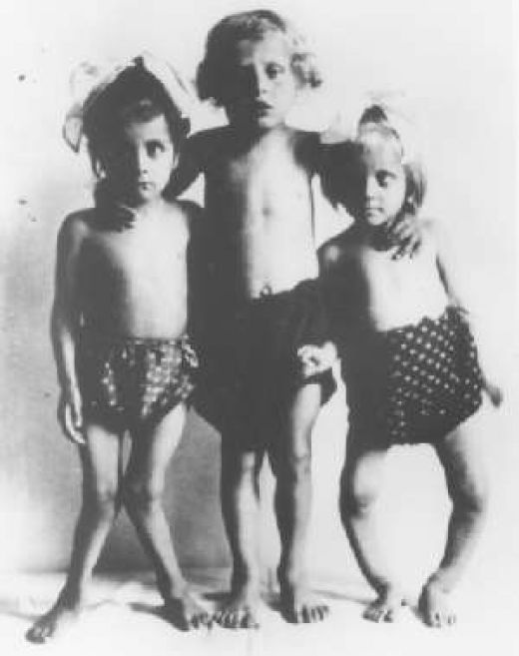
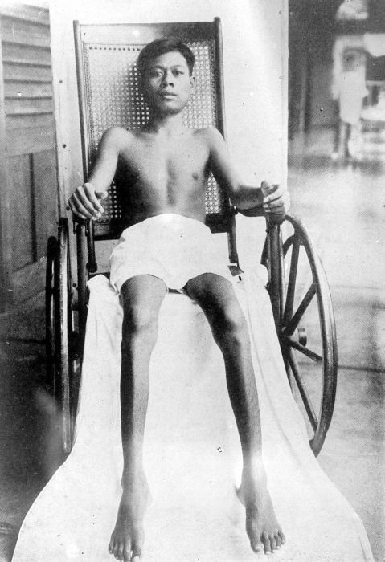
Vitamin –B1 - Thiamine is also known as
Vitamin B₁.
It is needed for the activity of some of the
enzymes of carbohydrate metabolism.
Deficiency disease - Beri-Beri.
In this disease, the calf muscles become tender,
vomiting, tremors, convulsions, loss of appetite are seen.
Sources: Cereals like wheat, oil seeds like groundnut, milk, meat, fish.

Slide 7
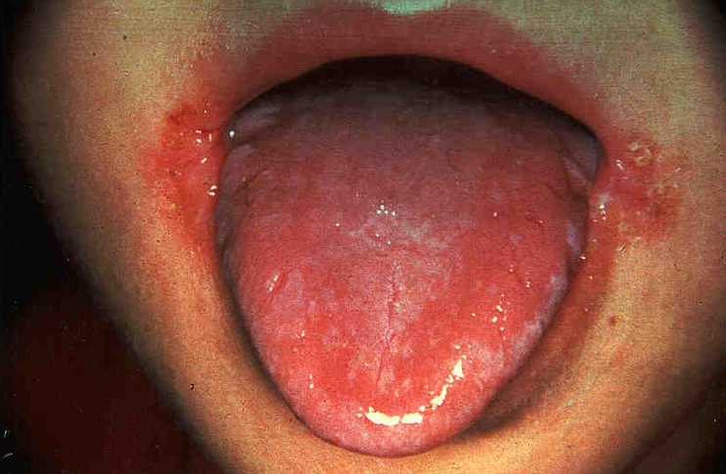
RIBOFLAVIN -
Riboflavin is otherwise known as Vitamin-B₂.
Functions: Riboflavin is essential for oxidation reduction reactions in the cell and in cellular respiration.
Sources: It is present in milk, eggs, liver, kidney and green leafy vegetables.
Deficiency disorders: Deficiency of riboflavin result in Glossitis
Mouth cracks at corners.
Photophobia, scaly skin and watering of eyes are some of the
symptoms.

Slide 8
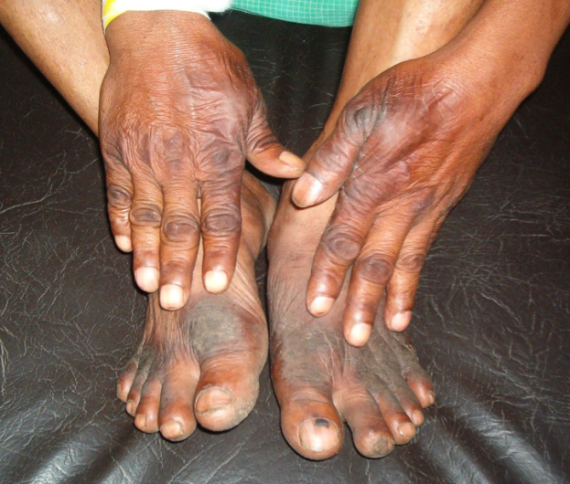
NIACIN:
Niacin is one of the ‘B’ Complex Vitamins. It is also known as Vitamin B₃.
Functions: Niacin is essential for the metabolism of carbohydrates, proteins and fats.
Sources: It is present in kidney, liver, meat, poultry fish, legumes and groundnuts.
Deficiency disorders: Deficiency of niacin in diet result a disease called Pellagra. The symptoms of pellagra are diarrhea, dementia (loss of memory) patches on the body when exposed to sunlight .

Slide 9
PYRIDOXINE:
Pyridoxine is otherwise called Vitamin-B₆.
Functions: Pyridoxine plays an important role in the metabolism of amino acids.
Sources: It is present in milk, liver, meat, egg yolk, fish, cereals, legumes and vegetables.
Deficiency disorders: Deficiency lead to hyper irritability, anaemia, nausea and in children it leads to convulsions.

Slide 10
Folic Acid :
Sources: It is present in liver, meat, eggs, milk, fruits, cereals, and leafy vegetables over cooking of food destroys the folic acid
Functions :
Folic acid is required for the synthesis of nucleic acids (DNA and RNA).
It is also required for the development of blood cells in the bone marrow.
Deficiency Symptoms: Its deficiency causes anemia, diarrhoea and decrease in the number of leucocytes.
Cell division in tissues such as intestinal mucosa is affected in folic acid deficiency.

Slide 11
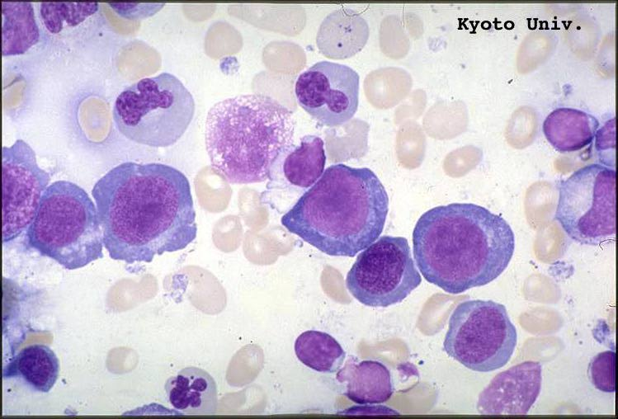
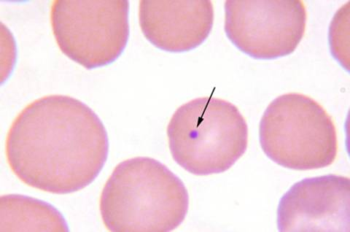
Cyano cobalamin: It is also known as vitamin B₁₂.
Functions:
It plays an important role in the metabolism of nucleic acid of protein synthesis.
Sources :
Bacteria present in the intestine synthesize this vitamin and supply to our body.
Liver is the main site of storage of vitamin B₁₂
Deficiency diseases :
Deficiency of this vitamin causes pernicious anemia that is different from other types of anaemia.

Slide 12
PANTOTHENIC ACID
It is one of the ‘B’ complex vitamins.
Functions: It is required for the metabolism of carbohydrates, proteins and fats.
Sources: The sources of pantothenic acid are fresh vegetables, liver, kidney, yeast, egg yolk, meat, ground nuts etc.
Deficiency leads to burning sensation in feet

Slide 13
BIOTIN
Biotin is one among the ‘B’ complex vitamins.
Functions: It is required for protein metabolism.
Sources: Biotin is present in pulses, nuts, vegetables, liver and kidney.
Deficiency disorders: Deficiency leads to muscle pains, fatigue, disorders in the nervous system and mental depression.

Slide 14
Vitamin C – It is also called as Ascorbic Acid
Sources: Vitamin C is present in fresh fruits, green leafy vegetables, tomatoes and germinating pulses.
Citrus fruit and Indian gooseberry are the richest source of this vitamin.
Guava is another cheap and rich source of Vitamin C.
Functions
Vitamin C plays an important role in tissue oxidation reactions.
It is required for the formation of collagen which is required for the formation of blood vessels, connective tissue, cartilage and dentine of teeth.
Vitamin C also helps in the absorption and storage of iron.
This Vitamin is also required for normal growth, tissue repair, healing of wounds and fracture of bone.

Slide 15
Deficiency disease - SCURVY:
Scurvy is the nutritional disorder caused due to the deficiency of Vitamin ‘C’.
The symptoms of this disease are swelling of gums, bleeding from gums and from the joints and under the skin.
This disease is preventable by providing the diet that is rich with Vitamin-‘C’.

Slide 16
Fat soluble vitamins are -
vitamin - A
Vitamin – D
Vitamin – E
Vitamin - K

Slide 17
Vitamin - A
The chemical name of Vitamin A is Retinol.
It is also called as Antixeropthalmic Vitamin
Sources - It is readily available in foods of Liver, eggs, butter, whole milk, fish, meat, oils extracted from fishes such as cod liver oil and shark liver oil.
In plants vitamin ‘A’ is present in the form of a carotene. In green leafy vegetable (Spinach amaranth etc.,) other vegetable like carrots, tomato, pumpkin, fruits like papaya and mango and its converted into vitamin ‘A’ in our body.

Slide 18
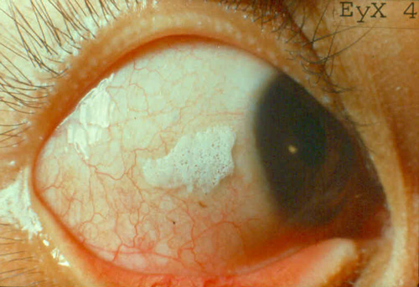
Deficiency of vitamin A: Deficiency leads to a variety of disorders of the eyes and this affect the vision, some of the disorders are –
1)Night blindness: The person cannot see the objects in dim light and in nights.
2)Xeropthalmia (or) Dry eyes: The lacrimal
glands in the eyes do to produce tears.
The conjunctiva (or) the outer most layer of the eye becomes dry
3)The cornea becomes soft and burst open. This leads to the loss of vision and permanent blindness - the major cause of blindness in children.
4)Skin become scaly, rough and is covered with papillae (Small eruptions). The skin looks like that of a toad.
5)Reproductive functions may also be effected in vitamin ‘A’ deficiency.
National Institute of Nutrition, Hyderabad has evolved a method giving a large dose (5 – 6 drops) of Vitamin-A once in six months to prevent blindness in children

Slide 19
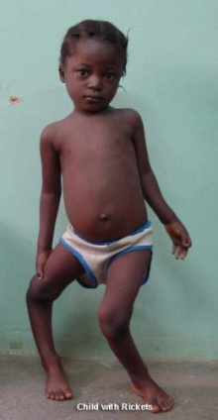
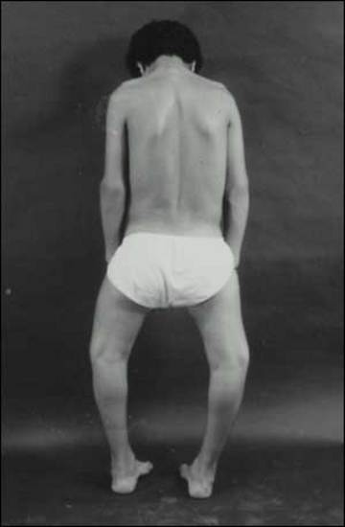
Vitamin ‘D’-
The chemical name of vitamin ‘D’ is Calciferol
Function - It helps in the absorption of Ca & P by the intestine and its deposition on the bones.
The rich source of Vitamin ‘D’ is sun light and sun light has the capacity to convert cholesterol in our body into Vitamin ‘D’.
Deficiency of vitamin ‘D’ leads to bone deformities such as Rickets. (bent bones and knock knees)

Slide 20
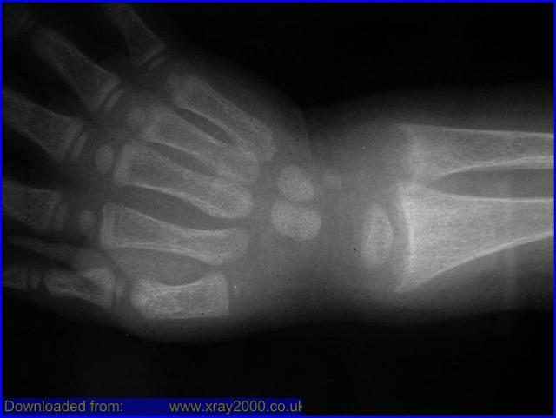
Sources -
Vitamin ‘D’ present in foods of animal origin such as liver, egg yolk, butter, oils extracted from the livers of fishes such as cod or shark.
It is formed in the skin from a cholesterol derivative by the action of Ultra Violet rays of sunlight

Slide 21
VITAMIN-E
Vitamin-E is also called as Tocoferol or Anti sterility Vitamin.
Functions: This vitamin is required for the normal functioning of sex organs.
Sources: It is present in fruits, vegetables, germinating seeds, meat, egg yolk, sunflower oil, cotton seed oil etc.,
Deficiency disorders: Deficiency leads to sterility in males and abortions in females and also reduces the life span or R.B.C.

Slide 22
VITAMIN-K
Vitamin K is also known as Anti coagulation Vitamin.
Functions: It is required for blood clotting.
Sources: It is present in green leafy vegetables and in cow milk, in man this vitamin is synthesized by the bacteria present in the intestines.
Deficiency disorders: deficiency results in long time for the blood to clot and loss of more blood from injuries

Slide 23
FACTS OF VITAMINS
Vitamins are very sensitive to heat. Over cooking leads to destruction of its chemical nature and some times leads toxic.
Excess intake of antibiotics, destroy useful bacteria in our intestine, further leads to vitamin B ₁₂ deficiency.
Consuming highly polished rice, leads to vitamin B₁ deficiency.

